Slide 1
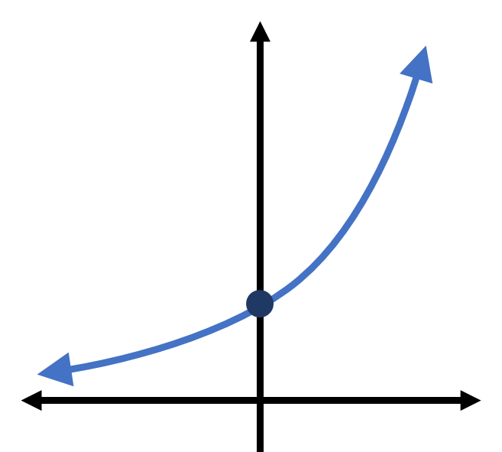

Slide 2

$$a^{x}$$

Slide 3

$$\left(0, 1\right)$$

Slide 4
$$\left(0, 1\right)$$

Slide 5

$$\left(0, 1\right)$$

Slide 6
x | lim[x->0](1+x)^(1/x)
1 | 2
0.1 | 2.59374246
0.01 | 2.704813829
0.001 | 2.716923932
0.0001 | 2.718145927
0.00001 | 2.718268237
0.000001 | 2.718280469
1E-07 | 2.718281694
1E-08 | 2.718281786
1E-09 | 2.718282052
1E-10 | 2.718282053
0 | 2.718281828

